Slide 1

9-dars
For loop

Slide 2
Dars rejasi:
9.1 Takrorlash operatorlari
9.2 O’zgaruvchini takror ekranga chiqarish
9.3 For loop list, tuple, setlar uchun
9.4 For loop dictionary uchun
9.5 For loop string uchun
9.6 range generatori
9.7 Nested loop
9.8 break, continue

Slide 3
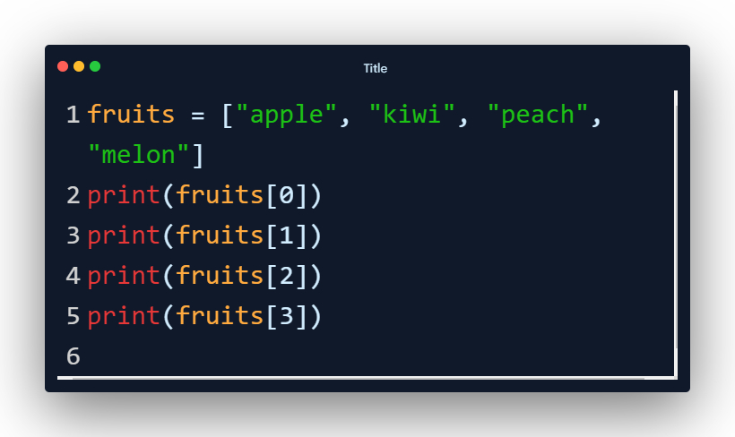
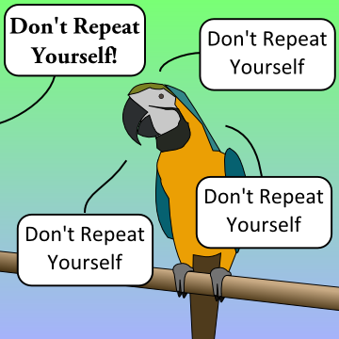
9.1 Takrorlash operatorlari
O’zingni takrorlama
O’zingni takrorlama
O’zingni takrorlama
O’zingni takrorlama

Slide 4
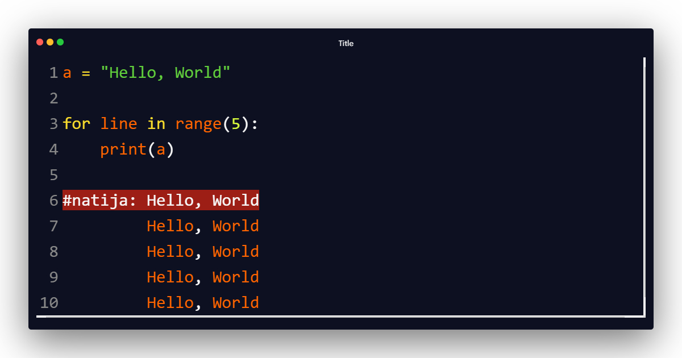
9.2 O’zgaruvchini takror ekranga chiqarish

Slide 5
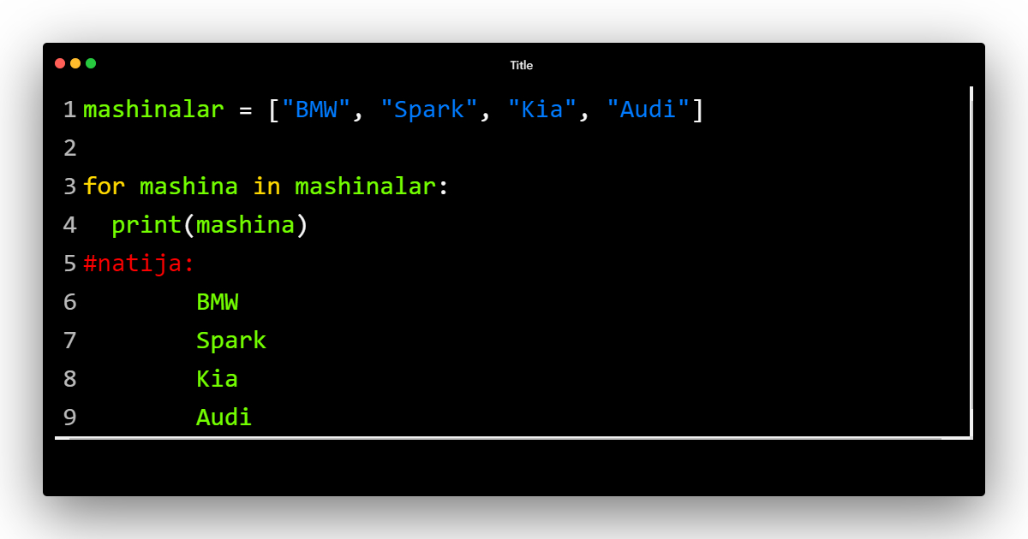
9.3 For loop list, tuple, set uchun

Slide 6
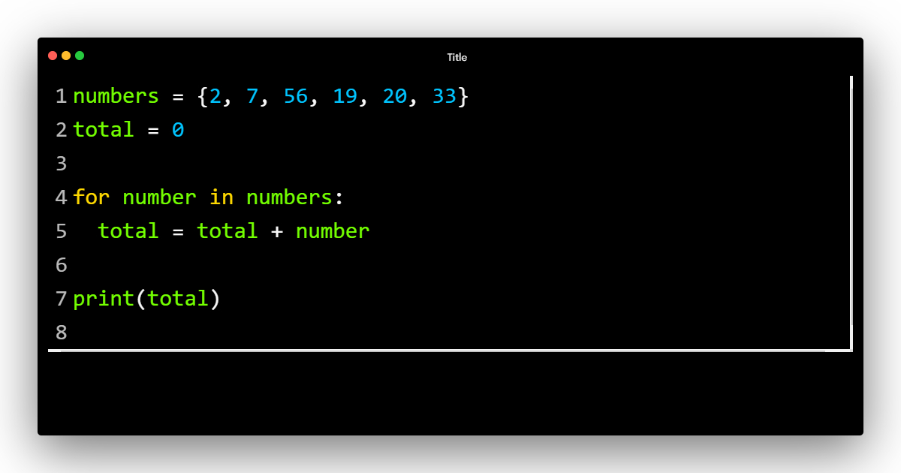
9.3 For loop list, tuple, set uchun

Slide 7
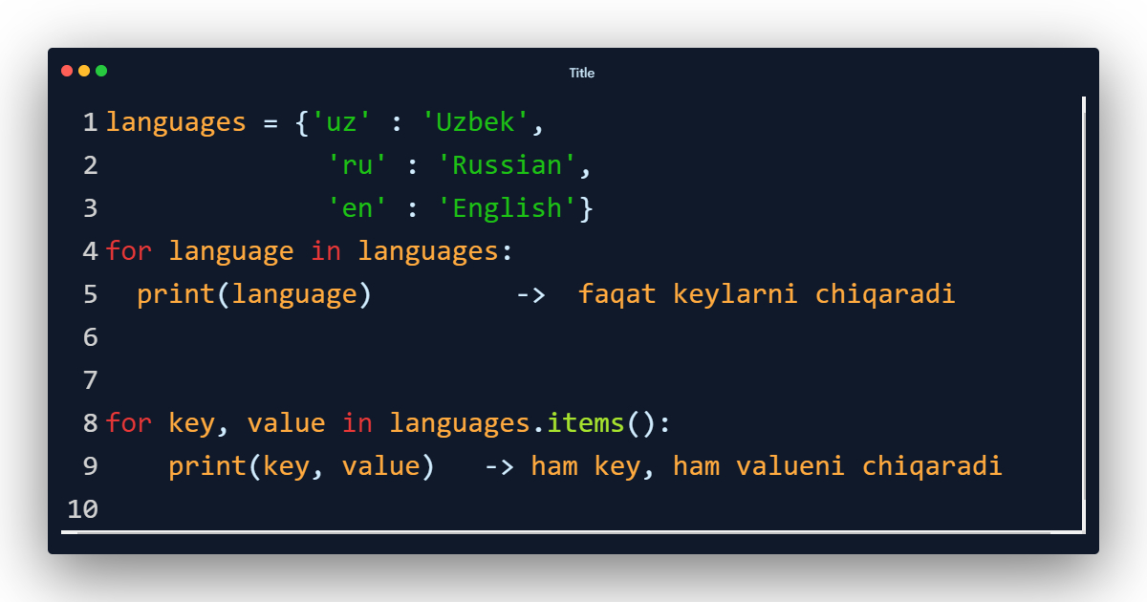
9.4 For loop dictionary uchun

Slide 8
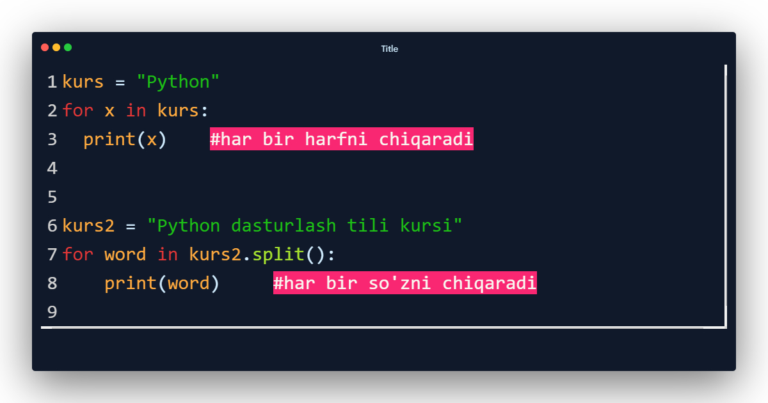
9.5 For loop string uchun

Slide 9
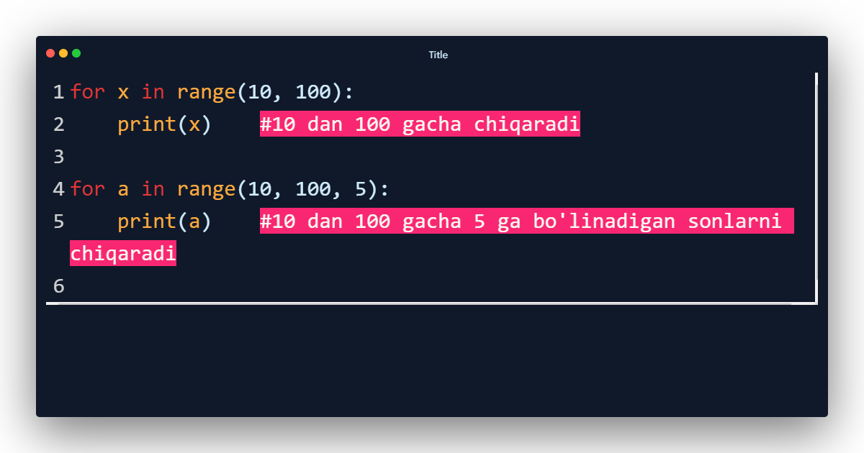
9.6 range generatori

Slide 10
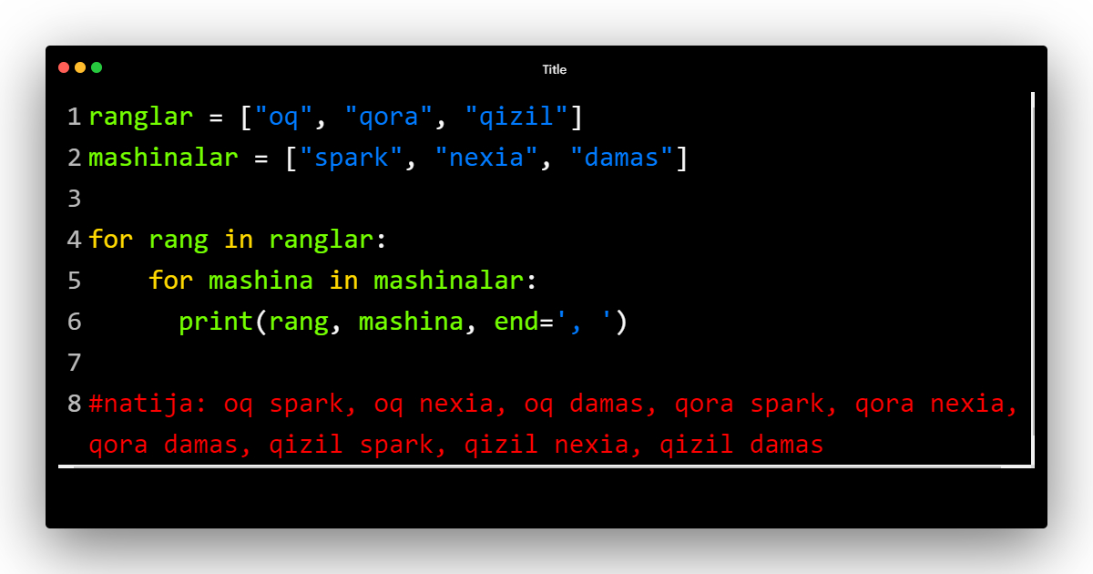
9.7 Nested looplar

Slide 11
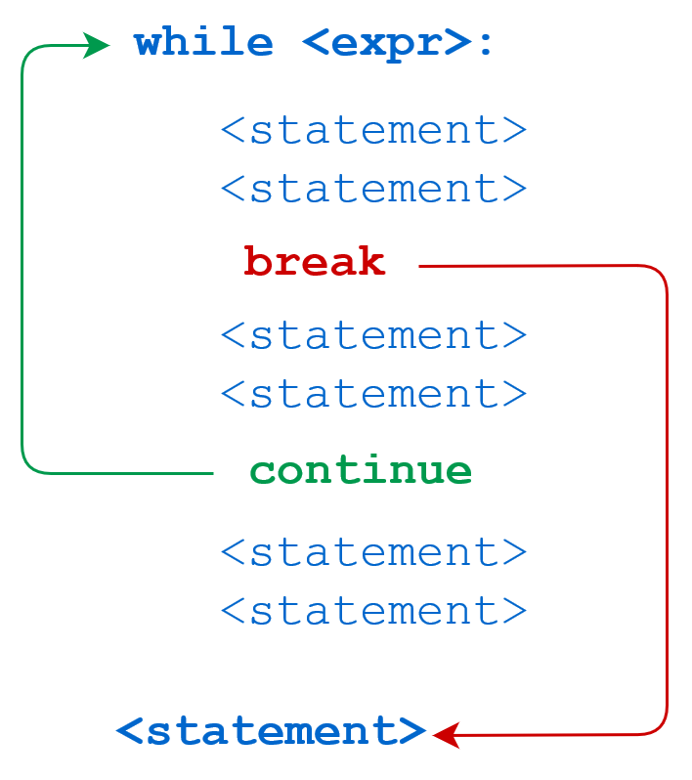
9.8 break, continue
For <sharti>

Slide 12
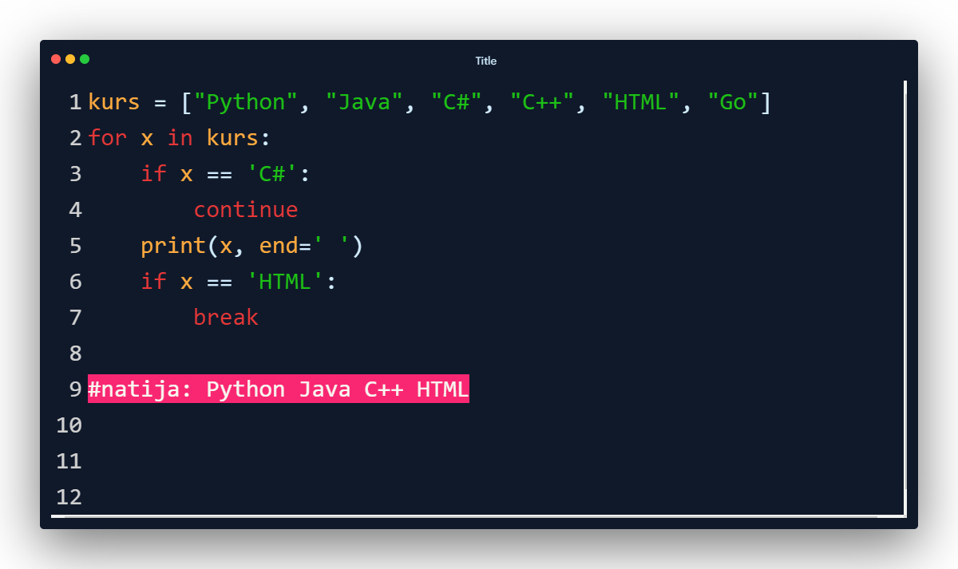
9.8 break, continue

Slide 13
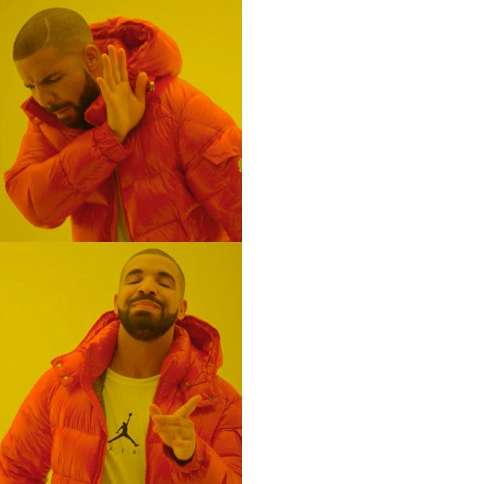
fruits = (‘apple’, ‘kiwi’, ‘orange’, ‘banana’)
print(fruits[0])
print(fruits[1])
print(fruits[2])
print(fruits[3])
fruits = (‘apple’, ‘kiwi’, ‘orange’, ‘banana’)
for a in fruits:
print(a)

Slide 14

Mashqlar
Men: Mashq qilamizmi?
O’quvchilar:

Slide 15


